Slide 1
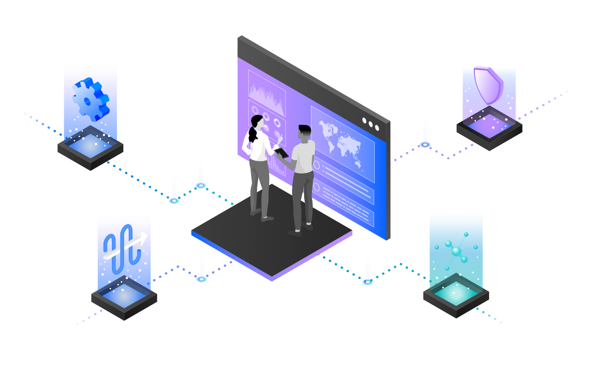
IBM Cloud Pak for Integration – IBM MQ
Access backend systems using Messaging and Integration
—
Chris Bienko Principal, Learning Content Development, Automation Software
Rafael Osorio Senior, Learning Content Development, Automation Software
Notes:
Today we will be demonstrating how IBM Cloud Pak for Integration can automate customer interactions using Messaging and Integration for back-end applications.

Slide 2



Customer Satisfaction Matters!
Automating Customer Interactions can:
Drive additional revenue
Reduce costs
remove manual steps, data entry into multiple different applications, and potential errors and delays
happy customers buy more; disappointed customers look for alternatives.
Notes:
Automating customer interactions effectively can mean the difference between a satisfied customer (one who will want to do more business with you in the future) or a disappointed customer (who will afterwards be looking for alternative options.)
Automation in this context can also reduce the manual steps involved in customer interactions, cut down on data entry into multiple different applications, and potentially eliminate errors and delays – all of which are additional costs to your business.

Slide 3
Automate customer interactions using messaging
The demo will showcase ways to automate customer interactions. To implement this automation, we will use both Messaging and Integrations to back-end applications.
IBM MQ provides a universal messaging backbone with robust connectivity options. It delivers flexible and reliable messaging for applications, as well as easily-managed integrations to existing IT assets.
IBM MQ simplifies, accelerates, and facilitates the reliable exchange of data with a flexible and security-rich messaging solution that’s trusted by some of the world’s most successful enterprises.
With IBM MQ, clients receive the information they need, when they need it — and receive it only once.
Notes:
The demo will showcase ways to automate customer interactions. To implement this automation, we will use both Messaging and Integrations to back-end applications.
We will be using the Messaging capability from IBM Cloud Pak for Integration: IBM MQ.
IBM MQ provides a universal messaging backbone with robust connectivity options. It delivers flexible and reliable messaging for applications, as well as easily-managed integrations to existing IT assets.
IBM MQ simplifies, accelerates, and facilitates the reliable exchange of data with a flexible and security-rich messaging solution that’s trusted by some of the world’s most successful enterprises.
With IBM MQ, clients receive the information they need, when they need it — and receive it only once.

Slide 4
Demonstration Agenda
1
Accessing the environment
4
Deploying the App Integration flow
Create a queue
Testing the Integration flow
2
5
Configuring the App Integration flow
3
Notes:
In terms of agenda, the demonstration will showcase the following steps: - How to access the Cloud Pak for Integration environment and explore the Messaging capabilities - Create a Queue; - Configure the App Integration flow; - Deploy the App Integration flow;
- Test the Integration flow;

Slide 5

Demonstration
Notes:
See script documentation for assistance in demo execution

Slide 6
Demonstration Summary
In this demo we:
Accessed the Cloud Pak for Integration environment and explored the capabilities
Created a queue in IBM MQ
Imported and configured an Integration flow using IBM App Connect Enterprise Toolkit
Deployed the flow into the Cloud Pak runtime environment
Deployed and tested our application flow
From a business perspective, we unified messaging and application connectors to integrate backend systems using the IBM MQ messaging platform. IBM MQ simplifies, accelerates, and facilitates the reliable exchange of data with a flexible and security-rich messaging solution that’s trusted by some of the world’s most successful enterprises.
Notes:
Let’s summarize what we’ve done today.
In the demo we: accessed the Cloud Pak for Integration environment and explored the capabilities; created a queue in IBM MQ; imported and configured an Integration flow using IBM App Connect Enterprise toolkit; deployed and tested our Application flow.
From a business perspective, we unified messaging and application connectors to integrate backend systems using the IBM MQ messaging platform. IBM MQ provides a universal messaging backbone with robust connectivity for flexible and reliable messaging across applications and existing IT assets. IBM MQ simplifies, accelerates, and facilitates the reliable exchange of data with a flexible and security-rich messaging solution that’s trusted by some of the world’s most successful enterprises.

Slide 7
Thank you
First Lastname
Job Title
—
firstlastname@us.ibm.com
+1-555-666-5555
ibm.com
© Copyright IBM Corporation 2021. All rights reserved. The information contained in these materials is provided for informational purposes only and is provided AS IS without warranty of any kind, express or implied. Any statement of direction represents IBM’s current intent, is subject to change or withdrawal, and represent only goals and objectives. IBM, the IBM logo, ibm.com and IBM Automation are trademarks of IBM Corp., registered in many jurisdictions worldwide. Red Hat® and OpenShift® are trademarks or registered trademarks of Red Hat, Inc. or its subsidiaries in the United States and other countries. Other product and service names might be trademarks of IBM or other companies. A current list of IBM trademarks is available at Copyright and trademark information.
IBM Integration / © 2020 IBM Corporation
7
Notes:
Thank you!

Slide 8
8

